Slide 1
Data Structures
Stack and its applications

Slide 2
Stack data structure
Stack data structure is like a container with a single opening.
  Can only access element at the top
  Add/insert new items at the top
  Remove/delete an item from the top
Stack in real life:
  collection of elements arranged in a linear order.
    - stack of books, stack of plates, stack of chairs.

Slide 3
Stack
push
pop
A stack is open at one end (the top) only. You can push entry onto the top, or pop the top entry out of the stack.
Note that you cannot add/extract entry in the middle of the stack.
top
C
B
A
bottom

Slide 4
Last-in First-out (LIFO)
A
B
C
C
Insert(A);
Insert(B);
Insert(C);
Remove();
Remove();
Remove();
The last one inserted in is the first one removed out! (LIFO)
B
C
B
A
A
A
B
C
When we insert entries onto the stack and then remove them out one by one, we will get the entries in reverse order.
B
A
A

Slide 5
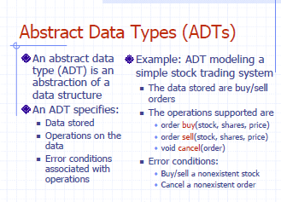
Dr. Kazi A. Kalpoma

Slide 6
Abstract Data Type ADT
A data type whose properties (domain and operations) are specified independently of any particular implementation
ADT is a mathematical model which gives a set of utilities available to the user but never states the details of its implementation.
In OO-Programming a Class is an ADT

Slide 7
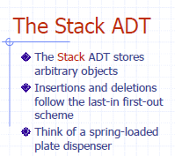
Dr. Kazi A. Kalpoma

Slide 8
Stack Operations
Push(X) – insert element X at the top of the stack and increment the top index.
Pop() – remove the element from the top of the stack with/without returning element and decrement the top index.
Top() – return the top element without removing it from the stack. top index does not change.

Slide 9
stack implementation by an array
#define stack_size 6;
int top;
int s[stack_size];
?
5 (stacksize-1)
?
4
?
3
?
2
?
1
?
0
s
top = 2
stack

Slide 10
Initialization of top index of Stack
stack_initialize()
{
top = -1;
}
?
5 (stacksize-1)
?
4
?
3
?
2
?
1
?
0
top
E--1ntry
top = 0
It can be initialize in different way too, Suppose
top = 0;

Slide 11
Push(X)
void push(int X)
{
if(top == stack_size-1)
cout<<“Overflow: stack is full”;
else
{
top++; /increase top by 1
s[top] = X; /insert the item on top
}
}
?
5 (stacksize-1)
?
4
?
3
?
2
?
1
top= 0 →1
top
X
0
entry
top++;
stack[top] = X;
if(top== stack_size)
cout <<”overflow: stack is full”;
else
{s[top] = X;
top++;}
S[++top] = X;

Slide 12
Pop()
void pop() //pop function is not returning
{
if(top<0)
cout<<"underflow: stack is empty”;
else
{
top--;
}
}
?
5
?
4
?
3
?
2
?
1
?
0
top
E--1ntry
entry
top= 1→0
if(top==0)
cout <<"underflow: stack is empty”;
else
{
top--;}

Slide 13
Pop() //pop function is returning the top element
int pop()
{
if(top<0)
cout<<"underflow: stack is empty”;
else
{
int X = s[top];
top--;
return X;
}
}
?
5
?
4
?
3
?
2
?
1
?
0
top
E--1ntry
entry
top= 1→0

Slide 14
Top()
int top() //top function is returning top value
{
return s[top]; //but not reduce top index
}
?
5
?
4
?
3
?
2
top= 1→0
top
R
1
K
0
int Top() //top function is returning top value
{
return s[top-1]; //but not reduce top index
}
entry

Slide 15
Other operations
int IsEmpty()
{
return ( top < 0 );
}
int IsFull()
{
return ( top >= stack_size-1);
}
?
5 (stacksize-1)
?
4
?
3
?
2
?
1
?
0
stack
top = 2
int IsEmpty()
{
return ( top == 0 );
}
int IsFull()
{
return ( top > stack_size-1);
}

Slide 16
// ……Program for stack implementation
#include <iostream>
using namespace std;
// here add all the initializations and
//functions’ definitions of stack.
int main()
{
push(9);
push(7);
push (8);
push (4);
pop ( );
push (5);
pop ( );
pop ( );
cout<< " top element of stack is = " << top() << endl;
cout << " top index is = " << top << endl;
}
?
5 (stacksize-1)
?
4
4
3
8
2
7
1
9
0
s
top = 2

Slide 17
// ……Program for stack implementation
#include <iostream>
using namespace std;
// here add all the initializations and
//functions’ definitions of stack.
int main()
{
push(9);
push(7);
push (8);
push (4);
pop ( );
push (5);
pop ( );
pop ( );
cout<< " top element of stack is = " << top() << endl;
bout << " top index is = " << top << endl;
}
?
5 (stacksize-1)
?
4
?
3
8
2
7
1
9
0
stack
top = 2

Slide 18
// ……Program for stack implementation
#include <iostream>
using namespace std;
// here add all the initializations and
//functions’ definitions of stack.
int main()
{
push(9);
push(7);
push (8);
push (4);
pop ( );
push (5);
pop ( );
pop ( );
cout<< " top element of stack is = " << top() << endl;
bout << " top index is = " << top << endl;
}
?
5 (stacksize-1)
?
4
5
3
8
2
7
1
9
0
stack
top = 2

Slide 19
// ……Program for stack implementation
#include <iostream>
using namespace std;
// here add all the initializations and
//functions’ definitions of stack.
int main()
{
push(9);
push(7);
push (8);
push (4);
pop ( );
push (5);
pop ( );
pop ( );
cout<< " top element of stack is = " << top() << endl;
cout << " top index is = " << top << endl;
}
?
5 (stacksize-1)
?
4
3
2
7
1
9
0
stack
top = 2
top element of stack is = 7
top index is = 1

Slide 20
// ……Program for stack implementation using stack class
#include <iostream>
#include <stack>
using namespace std;
int main()
{ stack <int> st;
st.push(9);
st.push(7);
st.push (8);
st.push (9);
st.pop ( );
st.push (5);
st.pop ( );
st.pop ( );
cout<< " top element of stack is = " << st.top() << endl;
bout << " top index is = " << st.size()-1 << endl;
}
top element of stack is = 7
top index is = 1

Slide 21
Traversing a stack
void show()
{
int i;
for(i=top; i>=0; i--)
cout<< “ “<<stack[i];
}
OUTPUT:
D C B A
?
?
top
D
3
C
2
B
1
A
0
Stack[ ]

Slide 22
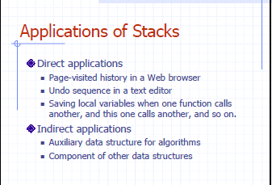
Dr. Kazi A. Kalpoma

Slide 23
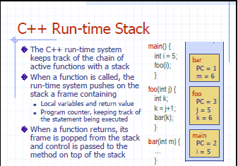
Dr. Kazi A. Kalpoma

Slide 24
Application of stack
Syntax parsing, Expression evaluation and Expression conversion.
Banking Transaction View
    - You view the last transaction first.
Backtracking and implementation of recursive function, calling function.
Towers of Hanoi
Inventory Systems like Issuing students the Multi-meters… you will be issued the most recently returned item likely

Slide 25
Validity checking of an arithmetic expression
When there is a opening parenthesis; brace or bracket, there should be the corresponding closing parenthesis. Otherwise, the expression is not a valid one. We can check this validity using stack.
Dr. Kazi A. Kalpoma

Slide 26
Stack in Problem Solving
Consider a mathematical expression that includes several sets of nested parenthesis, e.g
( x + (y – (a +b)) )
We want to ensure that parenthesis are nested correctly and the expression is valid
Validation
  There is an equal number of closing and opening parentheses
  Every closing parenthesis is preceded by a matching opening parenthesis

Slide 27
Algorithm
Whenever an opening is encountered, PUSH() on to stack
Whenever a closing is encountered,
  If stack is empty, expression is invalid.
  If stack is nonempty, POP() the stack and check with corresponding closing parenthesis. If match occurs continue. Otherwise expression is invalid.
When the end of expression is reached, stack must be empty; otherwise expression invalid.

Slide 28
Example:
[(A+B)-{(C+D)-E}]
Symbol | Stack
[ | [
( | [(
A | [(
+ | [(
B | [(
) | [
- | [
{ | [{
( | [{(
C | [{(
+ | [{(
D | [{(
) | [{
- | [{
E | [{
} | [
]

Slide 29
Algebraic Expression
An algebraic expression is a legal combination of operands and the operators.
Operand is the quantity (unit of data) on which a mathematical operation is performed.
Operand may be a variable like x, y, z or a constant like 5, 4,0,9,1 etc.
Operator is a symbol which signifies a mathematical or logical operation between the operands. Example of familiar operators include +,-,*, /, ^ , %
Considering these definitions of operands and operators now we can write an example of expression as
x+y*z

Slide 30
Infix, Postfix and Prefix Expressions
INFIX: From our schools times we have been familiar with the expressions in which operands surround the operator, e.g. x+y, 6*3 etc this way of writing the Expressions is called infix notation.
POSTFIX: Postfix notation are also Known as Reverse Polish Notation (RPN). They are different from the infix and prefix notations in the sense that in the postfix notation, operator comes after the operands, e.g. xy+, xyz+* etc.
PREFIX: Prefix notation also Known as Polish notation. In the prefix notation, as the name only suggests, operator comes before the operands, e.g. +xy, *+xyz etc.

Slide 31
Operator Priorities
How do you figure out the operands of an operator?
  a + b * c
  a * b + c / d
This is done by assigning operator priorities.
  priority(*) = priority(/) > priority(+) = priority(-)
When an operand lies between two operators, the operand associates with the operator that has higher priority.

Slide 32
Tie Breaker
When an operand lies between two operators that have the same priority, the operand associates with the operator on the left.
  a * b / c / d
  Delimiters
Sub expression within delimiters is treated as a single operand, independent from the remainder of the expression.
  (a + b) * (c – d) / (e – f)

Slide 33
WHY PREFIX and POSTFIX ?
Why to use these weird looking PREFIX and POSTFIX notations when we have simple INFIX notation?
To our surprise INFIX notations are not as simple as they seem specially while evaluating them. To evaluate an infix expression we need to consider Operators’ Priority and Associative property
  For example expression 3+5*4 evaluate to 32 i.e. (3+5)*4 or to 23 i.e. 3+(5*4).
To solve this problem Precedence or Priority of the operators were defined. Operator precedence governs evaluation order. An operator with higher precedence is applied before an operator with lower precedence.

Slide 34
Infix Expression Is Hard To Parse
Need operator priorities, tie breaker, and delimiters.
This makes computer evaluation more difficult than is necessary.
Postfix and prefix expression forms do not rely on operator priorities, a tie breaker, or delimiters.
So it is easier to evaluate expressions that are in these forms.

Slide 35
Both prefix and postfix notations have an advantage over infix that while evaluating an expression in prefix or postfix form we need not consider the Priority and Associative property (order of brackets).
  E.g. x/y*z becomes
  */xyz in prefix and
  xy/z* in postfix.
Both prefix and postfix notations make Expression Evaluation a lot easier.

Slide 36
When do we need to use them… ☺
So, what is actually done in expression is scanned from user in infix form; it is converted into prefix or postfix form and then evaluated without considering the parenthesis and priority of the operators.

Slide 37
Algorithm for Infix to Postfix
1) Examine the i^{th} element in the input, infix[i].
2) If it is operand, output it at k^{th} location (pop to postfix[k]).
3) else If it is opening parenthesis ‘(’, push it on stack.
4) else If it is a closing parenthesis ‘)’,
pop (operators) from stack and output to postfix[k] them until an opening parenthesis ‘(’ is encountered in the top of stack.
pop and discard the opening parenthesis ‘(’ from stack.
5) else If it is an operator ‘+’, ‘-’, ‘*’, ‘/’, ‘%’ then
  i) If stack is empty, push operator on stack.
  ii) else If the top of stack is opening parenthesis ‘(’, push on stack
  iii) else If it has higher priority than the top of stack, push on stack.
  iv) else pop the operator from the stack and output it, repeat step 5
6) If there is more input in infix[], go to step 1
7) If there is no more input, pop the remaining operators from stack to output.

Slide 38
Suppose we want to convert infix: 2 * 3 / ( 2 – 1 ) + 5 * 3 into Postfix form,
Input (infix) | Stack | Output (Postfix)
2 | Empty | 2
* | * | 2
3 | * | 23
/ | / | 23*
( | /( | 23*
2 | /( | 23*2
- | /(- | 23*2
1 | /(- | 23*21
) | / | 23*21-
+ | + | 23*21-/
5 | + | 23*21-/5
* | +* | 23*21-/5
3 | +* | 23*21-/53
 | Empty | 23*21-/53*+
So, the Postfix Expression is 2 3 * 2 1 - / 5 3 * +

Slide 39
Example
( 5 + 6) * 9 +3
will be
5 6 + 9 * 3 +
Conversion of infix to prefix: try it at home.

Slide 40
Evaluating Postfix Notation
Use a stack to evaluate an expression in postfix notation.
The postfix expression to be evaluated is scanned from left to right.
Variables or constants are pushed onto the stack.
When an operator is encountered, the indicated action is performed using the top elements of the stack, and the result replaces the operands on the stack.

Slide 41
Algorithm: To evaluate a postfix Expression
Add “)” at the right end of the expression.
Scan p from left to right and repeat step 3 and 4 for each element of p until encountered “)”.
If an operand is encountered, PUSH it in stack.
If an operator  is encountered, then
  To remove two element from stack Call POP() twice and first POP() put to A and second one to B.
  Evaluate C = B  A.
  PUSH(C) in stack.
Set the value = POP(), the top element of stack.
Exit

Slide 42
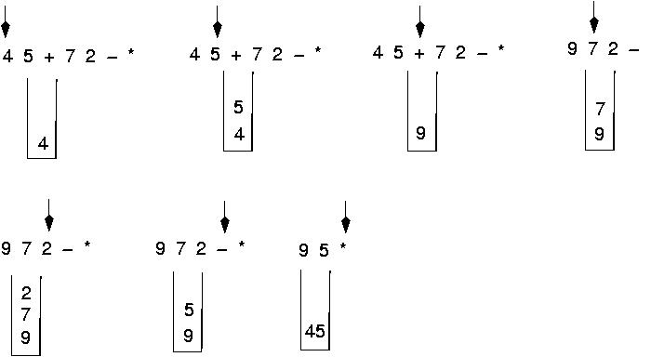
Postfix expressions:
Algorithm using stacks (cont.)

Slide 43
Question : Evaluate the following expression in postfix :
6 2 3 + - 3 8 2 / + * 2 ^ 3 +
Final answer is ?
49
51
52
7
None of these

Slide 44
Evaluate- 623+-382/+*2^3+ )
6
2
6
3
2
6
623+-382/+*2^3+)
65-382/+*2^3+) 1382/+*2^3+)
5
6
1
3
1
8
3
1
2
8
3
1
4
3
1

Slide 45
Cont. of Evaluation- 623+-382/+*2^3+
134+*2^3+)
72^3+) 493+) )
= 52
4
3
1
7
1
7
2
7
49
3
49
52

Slide 46
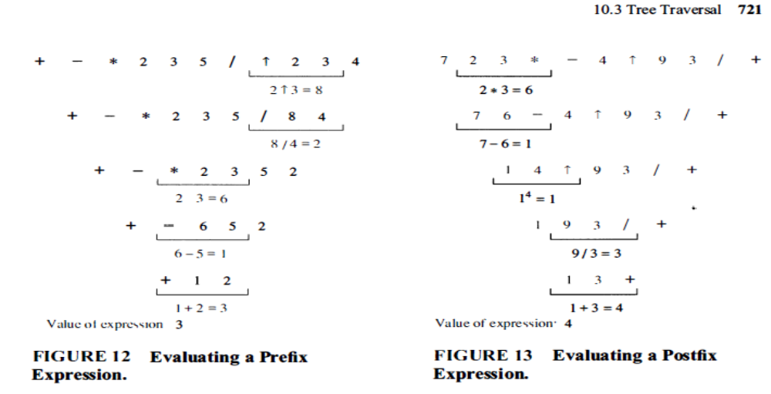

Slide 47
Algorithm: To evaluate a prefix value
Add “(” at the left end of the expression.
Scan p from right to left and repeat step 3 and 4 for each element of p until encountered “(”.
If an operand is encountered, PUSH it in stack.
If an operator  is encountered, then
  To remove two element from stack Call POP() twice and first POP() put to A and second one to B.
  Evaluate C = A  B
  PUSH(C) in stack.
Set the value = POP(), the top element of stack.
Exit

Slide 49
Stack Using Linked List
We can avoid the size limitation of a stack implemented with an array by using a linked list to hold the stack elements.
Notes:
End of lecture 5
You might believe that faster computers make it unnecessary to be concerned with efficiency. However…
So we need special training.

Slide 50
Stack Using Linked List
For a singly-linked list, insert at start or end takes constant time using the head and current pointers respectively.
Removing an element at the start is constant time but removal at the end required traversing the list to the node one before the last.
Make sense to place stack elements at the start of the list because insert and removal are constant time.
Notes:
A primary concern for this course is efficiency.
You might believe that faster computers make it unnecessary to be concerned with efficiency. However…
So we need special training.

Slide 51
Stack Using Linked List
No need for the current pointer; head is enough.
head
top
1
7
1
7
5
2
5
2
Notes:
A primary concern for this course is efficiency.
You might believe that faster computers make it unnecessary to be concerned with efficiency. However…
So we need special training.

Slide 52
Stack Operation: List
int pop()
{ int x = head->data;
Node* p = head;
head = head->Next;
delete p;
return x;
}
head
top
7
p
1
7
5
2
5
2
Notes:
A primary concern for this course is efficiency.
You might believe that faster computers make it unnecessary to be concerned with efficiency. However…
So we need special training.

Slide 53
Stack Operation: List
void push(int x)
{
Node* newNode = new Node();
newNode->data = x;
newNode->Next = head;
head = newNode;
}
head
top
9
7
7
5
2
5
newNode
9
2
push(9)
Notes:
A primary concern for this course is efficiency.
You might believe that faster computers make it unnecessary to be concerned with efficiency. However…
So we need special training.

Slide 54
Stack Operation: List
int top()
{
return ( head->data );
}
int IsEmpty()
{
return ( head == NULL );
}
IsFull() is not needed anymore.
Notes:
A primary concern for this course is efficiency.
You might believe that faster computers make it unnecessary to be concerned with efficiency. However…
So we need special training.

Slide 55
Stack: Array or List
Since both implementations support stack operations in constant time, any reason to choose one over the other?
Allocating and de-allocating memory for list nodes does take more time than pre-allocated array.
List uses only as much memory as required by the nodes; array requires allocation ahead of time.
List pointers (head, next) require extra memory.
Array has an upper limit; List is limited by dynamic memory allocation.
Notes:
A primary concern for this course is efficiency.
You might believe that faster computers make it unnecessary to be concerned with efficiency. However…
So we need special training.

